Slide 1

CytoAutoCluster: A Semi-Supervised Deep Approach for Cytometry Data Analysis
This explores CytoAutoCluster, a novel semi-supervised learning approach for cytometry data analysis. This approach leverages autoencoder-based feature learning and clustering techniques to overcome the challenges associated with high-dimensional cytometry data.
By,
Swarna Kudva K

Slide 2

Introduction and Background
1
Objective
2
Key Insight
To develop a semi-supervised clustering algorithm that effectively analyzes high-dimensional cytometry data.
Cytometry data analysis is crucial for understanding complex immune profiles and discovering disease-related biomarkers.
3
Challenges
Addressing the challenges of high dimensionality, noise, and label imbalance in cytometry data is essential.

Slide 3
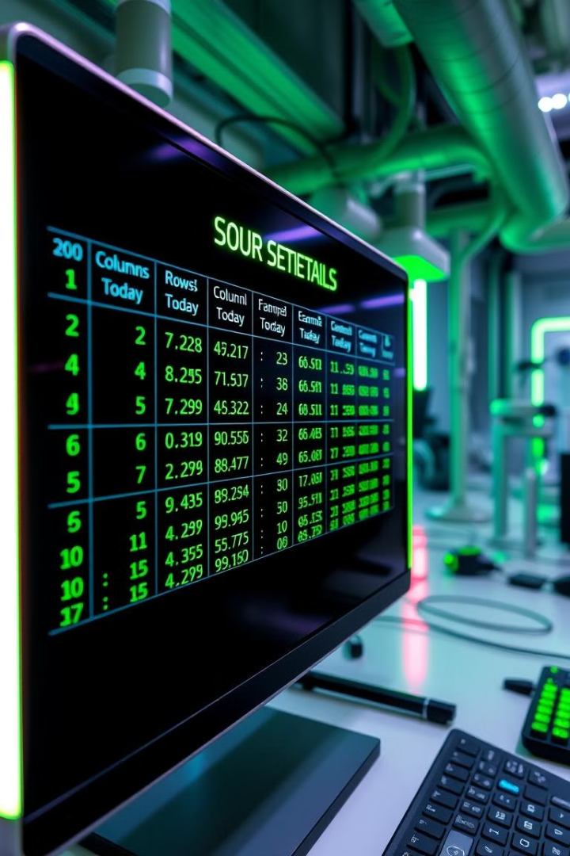
Dataset Overview
Characteristic
Details
Cells (n)
265,627
Columns
42
The Levine_32dim dataset is a benchmark dataset for clustering algorithms, publicly available on platforms like Cytobank. It is a challenging dataset due to its high dimensionality, label imbalance, and inherent noise.

Slide 4
Challenges in Cytometry Analysis
High Dimensionality
Noise
Label Imbalance
Each cell is characterized by 30+ markers, leading to complex data with high dimensionality.
Noise introduced by instrument variability and sample inconsistencies can affect data quality.
Rare cell types are often underrepresented, leading to challenges in learning representative models.

Slide 5


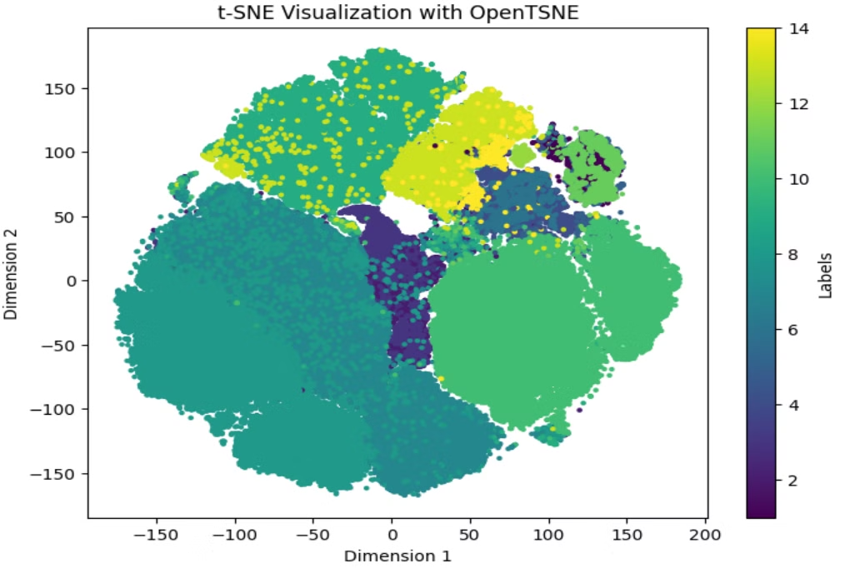

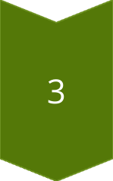
Methodology
Preprocessing
Data normalization and exploratory analysis, handling partially labeled datasets.
Clustering Techniques
Autoencoder-based dimensionality reduction, t-SNE visualization for cluster identification.
Visualizations
t-SNE plots reveal the initial distribution of cells before encoder implementation.

Slide 6

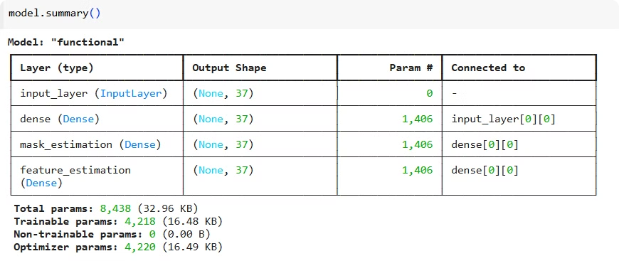
Model Architecture and Implementation
Semi-Supervised Learning
Training Details
Batch size, epochs, optimizers are chosen to optimize the model's performance. Class weights are used to address label imbalance.
Self-supervised encoder for feature extraction, supervised fine-tuning with logistic regression and XGBoost.

Slide 7
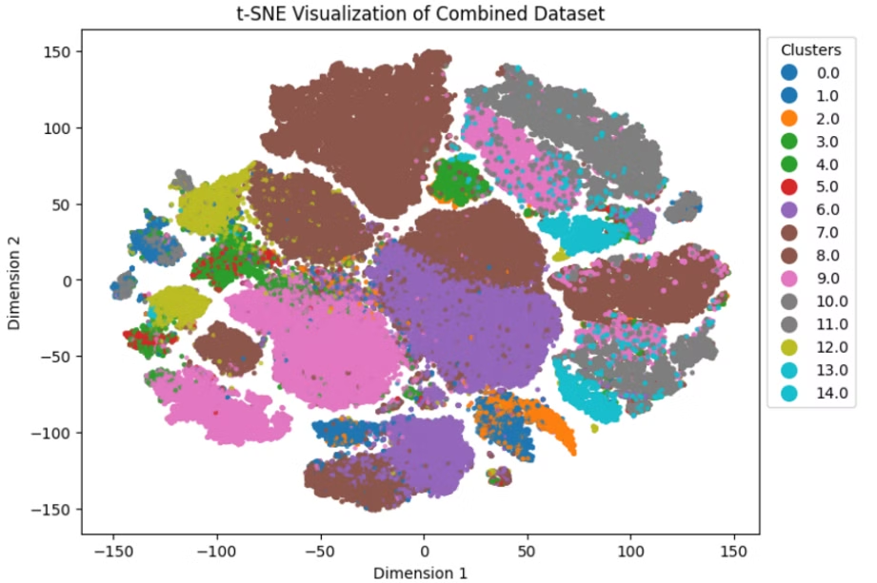
Results and Evaluation
Quantitative Metrics
Visual Insights
Logistic Regression Log Loss: 0.0649, XGBoost Log Loss: 0.0073, Self-Supervised Model Accuracy: 93.54%, AUROC: 99.09%
t-SNE plots visualize the distinct and well-separated clusters obtained after encoder implementation.

Slide 8

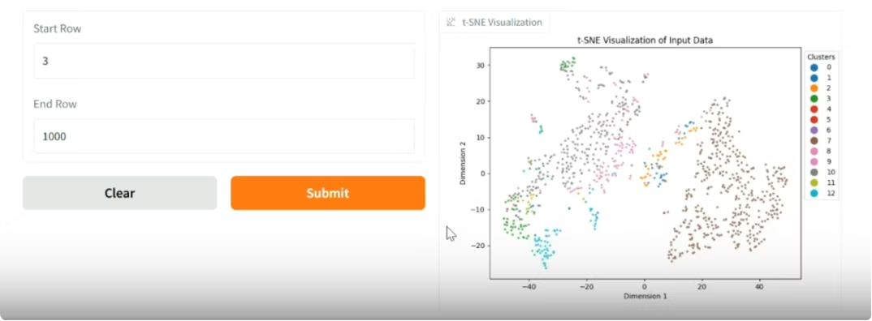



Gradio Interface for User Interaction
Visualization
Prediction
Interactive
Users can explore and visualize data subsets using t-SNE plots.
The interface predicts cell types dynamically based on user-selected data points.
The Gradio interface provides a user-friendly way to interact with the model and explore its results.

Slide 9

Thank you

